Slide 1
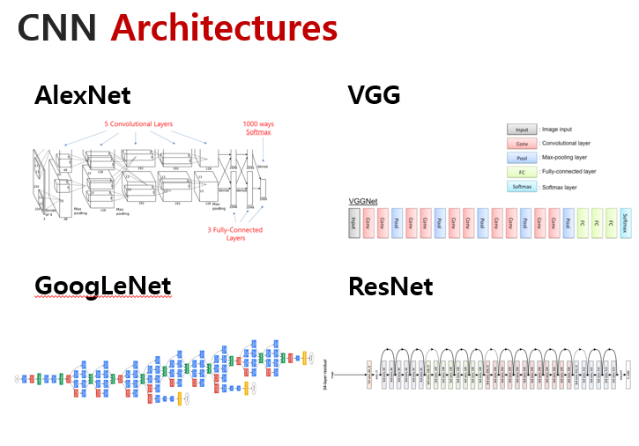
Review of
Previous lecture

Slide 2
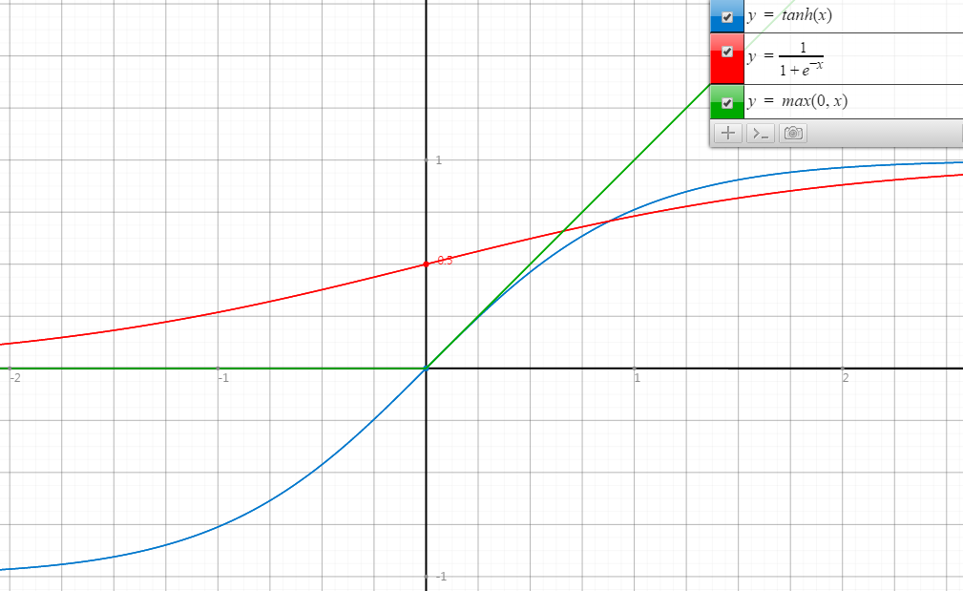
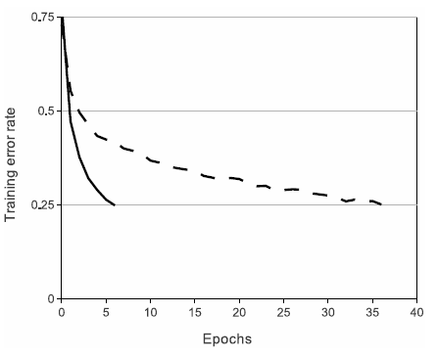
ReLU
Rectified Linear Unit
ReLU
tanh
Faster Convergence!

Slide 3
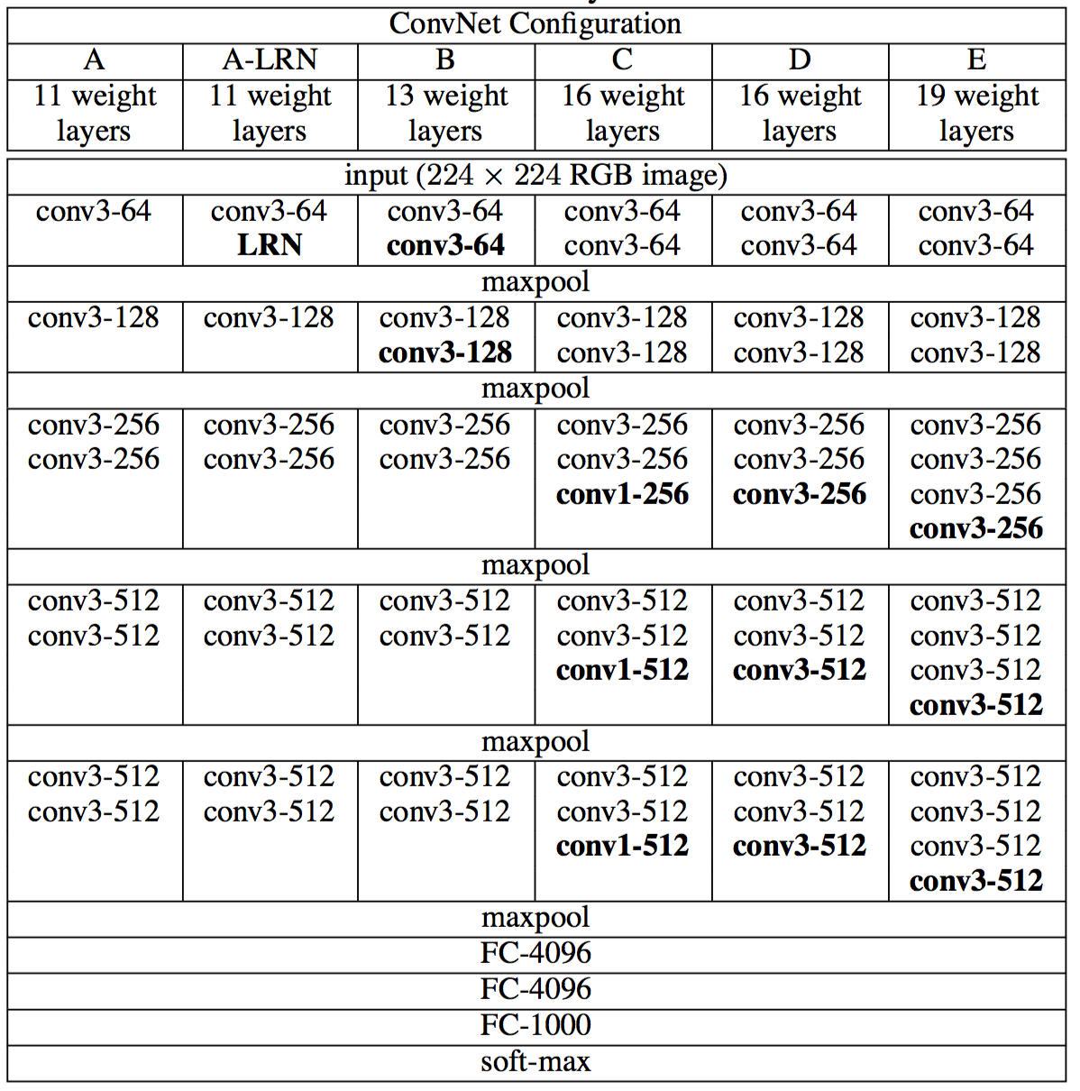
VGG?

Slide 4
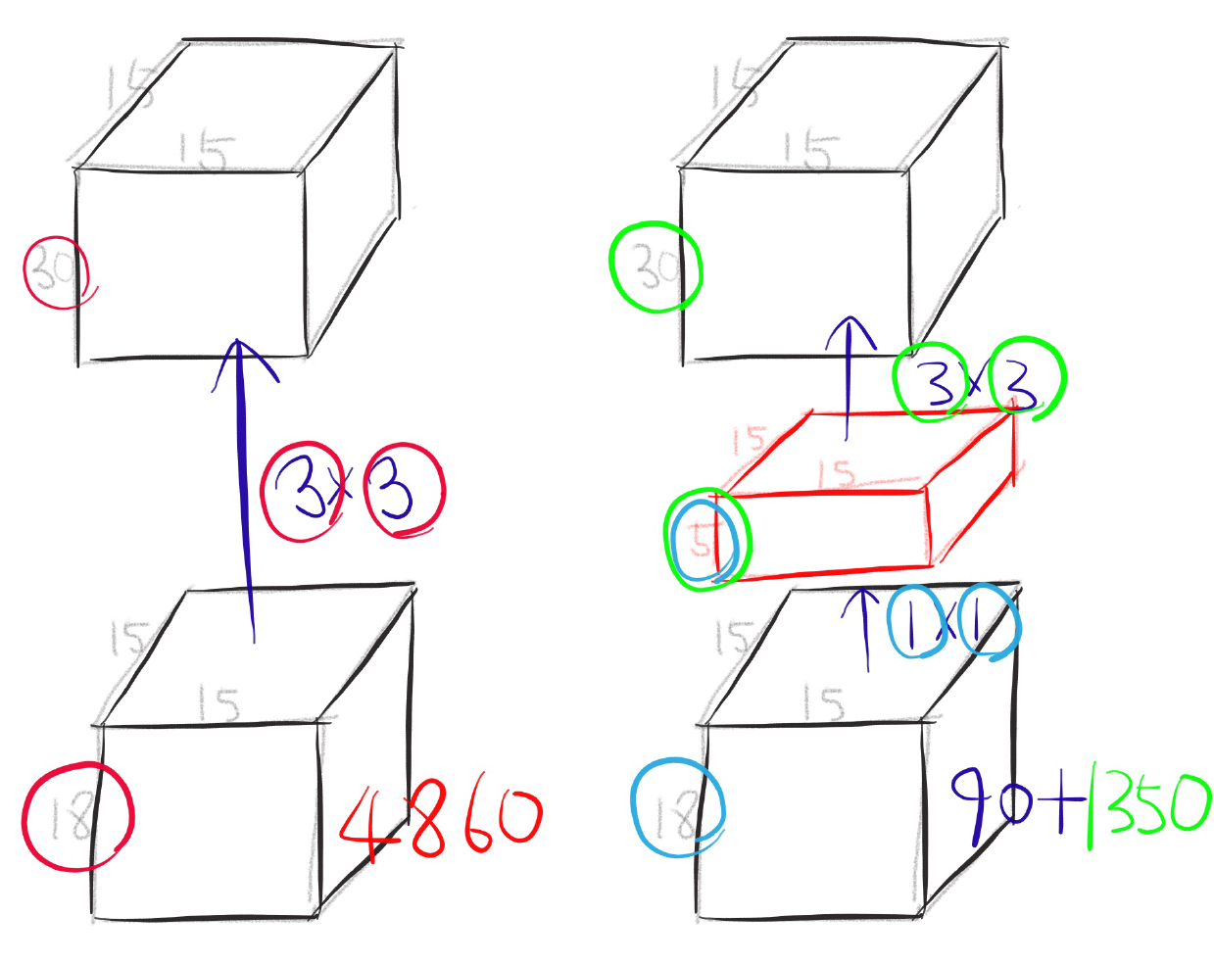
One by one convolution

Slide 5
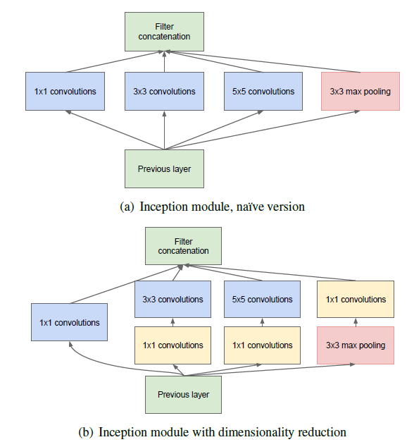
Inception module

Slide 6
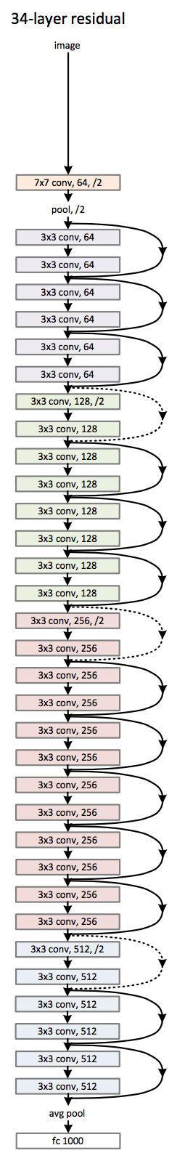
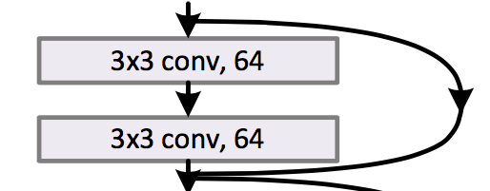
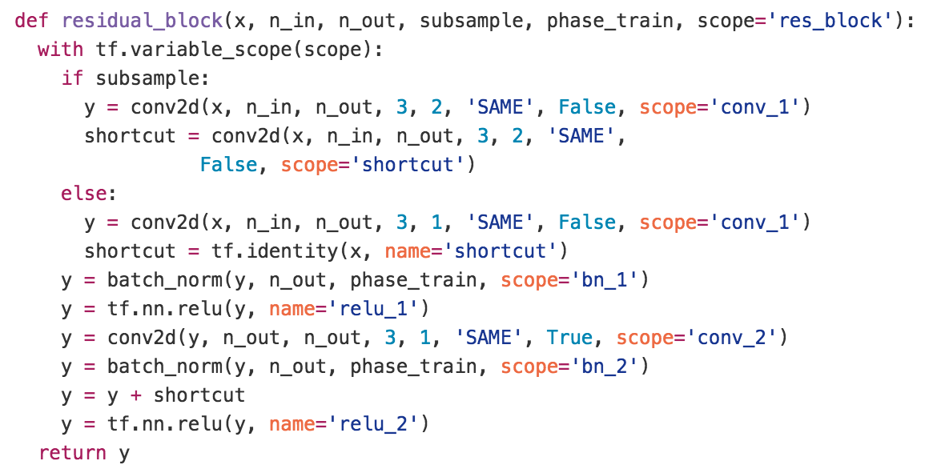
Deep residual network

Slide 7
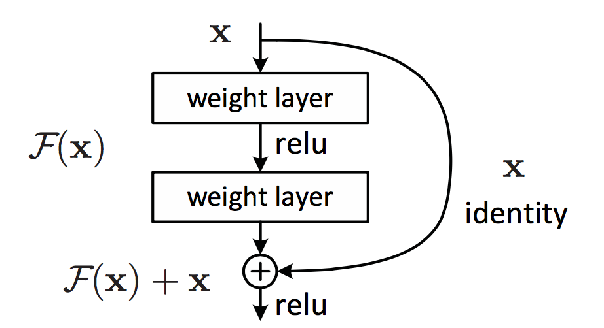
Residual learning building block

Slide 8
Regularization
Sungjoon Choi
(sungjoon.choi@cpslab.snu.ac.kr)

Slide 9

Regularization?
Main purpose is to avoid “OverFitting”
http://www.freedomsquare.co.kr/2347#.VvELE-KLQuU

Slide 10
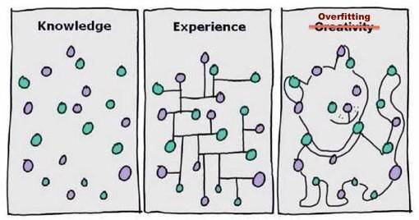
OverFitting?
This actually happens all the time!

Slide 11
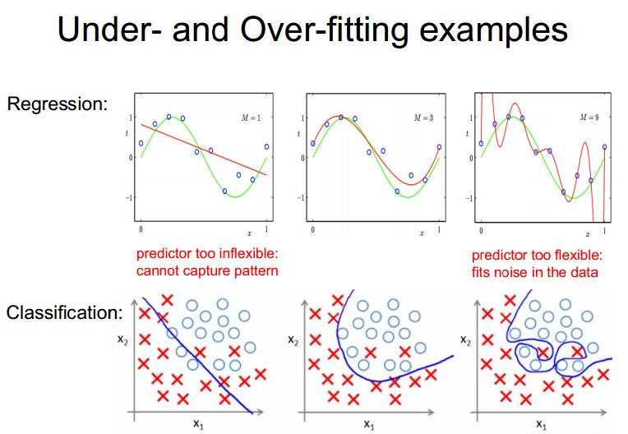
Examples

Slide 12
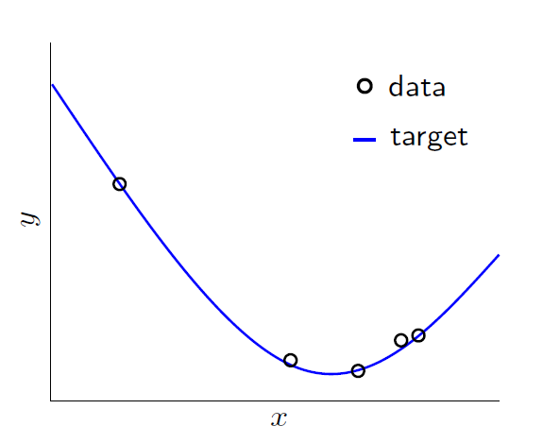
OverFitting
Literally, Fitting the data more than is warranted

Slide 13
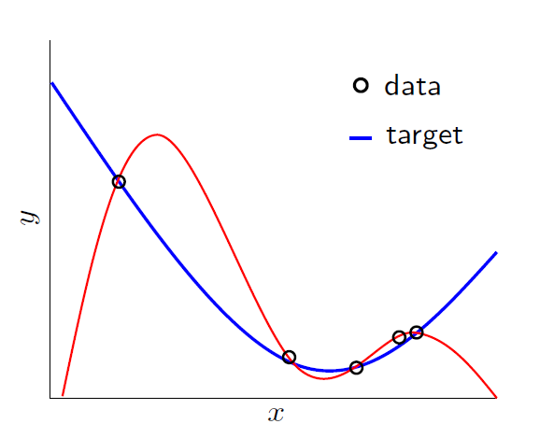
OverFitting
Literally, Fitting the data more than is warranted

Slide 14
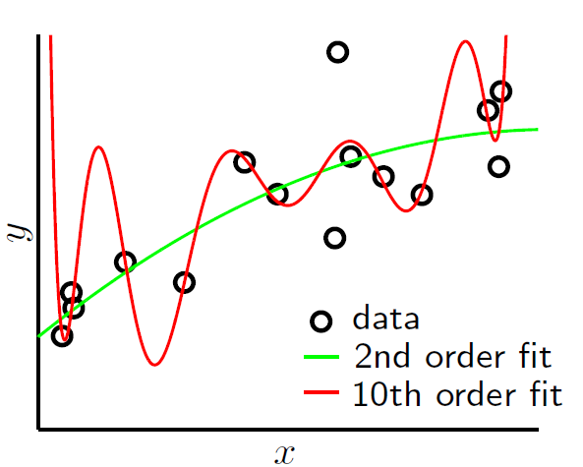
OverFitting
Things get worse with noise!

Slide 15
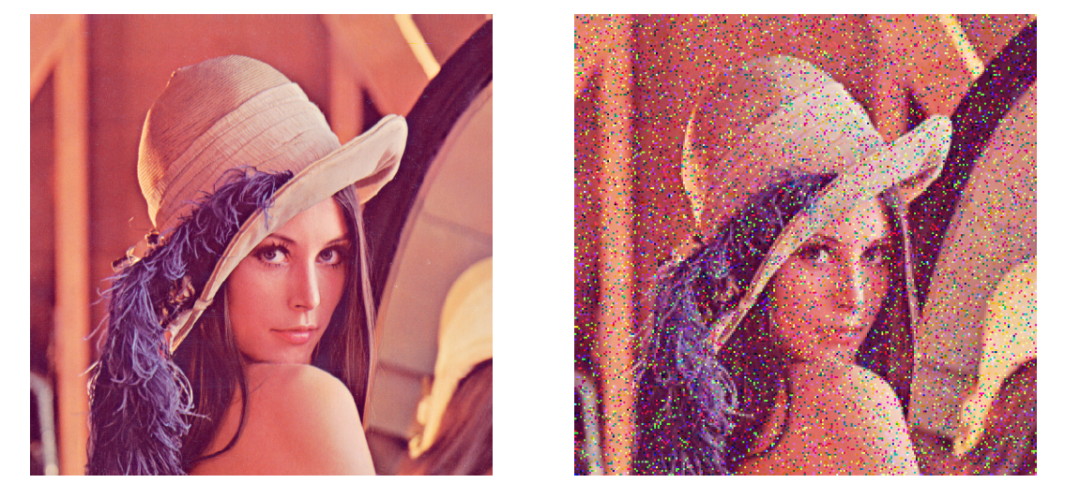
Stochastic Noise
Comes from random measurement error

Slide 16
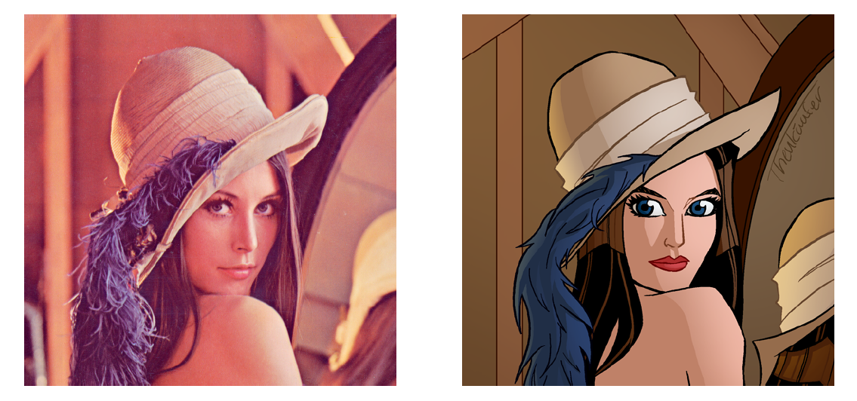
Deterministic Noise
Cannot model this type of error

Slide 17
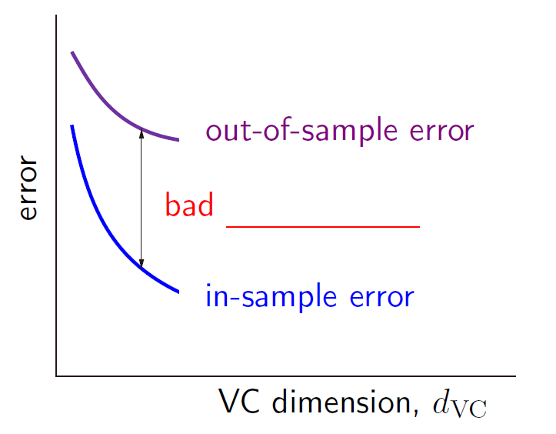
Mathematically,
Test error
Generalization performance
Training error
Complexity of the algorithm

Slide 18
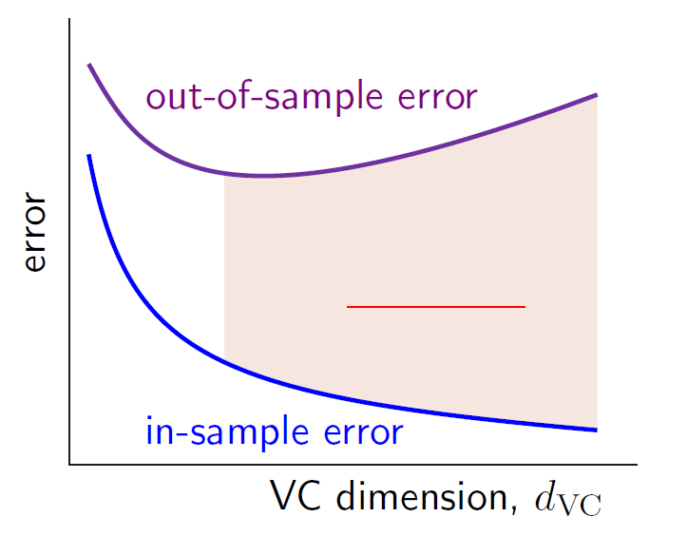
Mathematically,
Over fitting
Notes:
In Vapnik–Chervonenkis theory, the Vapnik–Chervonenkis (VC) dimension is a measure of the size (capacity, complexity, expressive power, richness, or flexibility) of a class of sets. The notion can be extended to classes of binary functions. It is defined as the cardinality of the largest set of points that the algorithm can shatter, which means the algorithm can always learn a perfect classifier for any labeling of at least one configuration of those data points. It was originally defined by Vladimir Vapnik and Alexey Chervonenkis.^{[1]} https://en.wikipedia.org/wiki/Vapnik%E2%80%93Chervonenkis_dimension

Slide 19
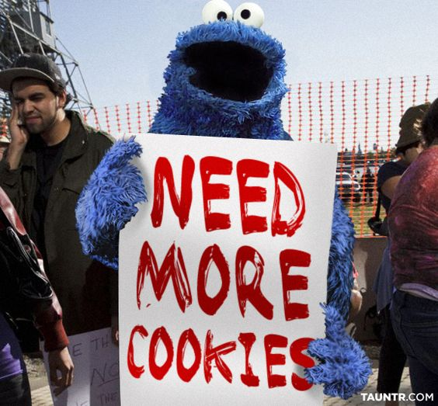


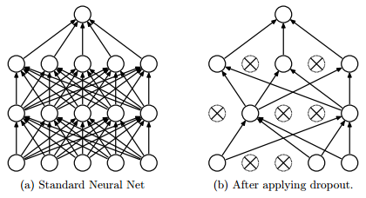
Preventing OverFitting?
Approach 1: Get more data
Approach 2: Use a model with the right capacity
Approach 3: Average many different models (Ensemble)
Approach 4: Use DropOut, DropConnect, or BatchNorm

Slide 20

Limiting the Capacity
Architecture: Limit the number of hidden layers and units per layer
Early stopping: Stop the learning before it overfits using validation sets
Weight-decay: Penalize large weights using penalties or constraints on their squared values (L2 penalty) or absolute values (L1 penalty)
Notes:
뒤에 나오니까 간단하게만 설명하기

Slide 21
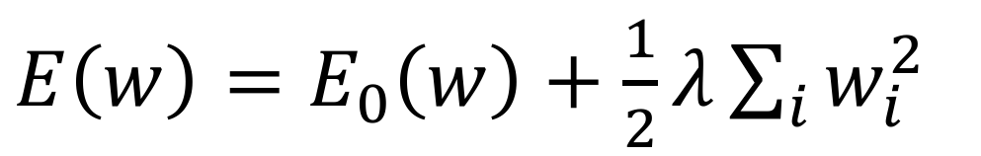
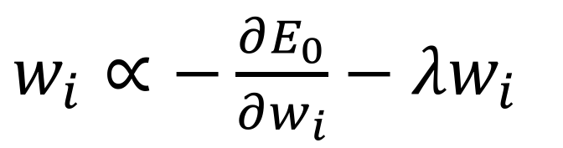
Weight Decay
$E\left(w\right)=E_{0}\left(w\right)+\frac{1}{2}λ\sum_{i}{w_{i}^{2}}$
$w_{i}∝−\frac{∂E_{0}}{∂w_{i}}−λw_{i}$
Anders Krogh and John A Hertz , "A simple weight decay can improve generalization." NIPS, 1995
Notes:
https://ko.d2l.ai/chapter_deep-learning-basics/weight-decay.html weight matrix가 클수록 복잡한 함수 -> loss에 추가

Slide 22
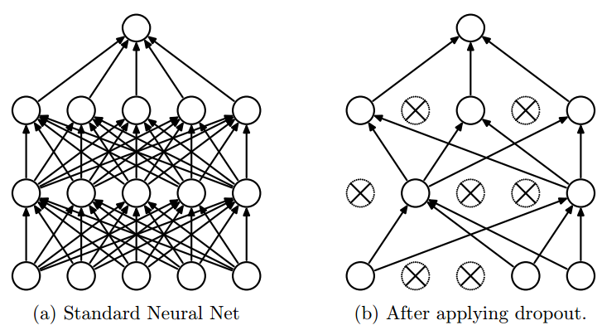
DropOut
DropOut increases the generalization performance of the neural network by restricting the model capacity!
Srivastava, Nitish, et al. "Dropout: A simple way to prevent neural networks from overfitting." The Journal of Machine Learning Research 15.1 (2014): 1929-1958.

Slide 23
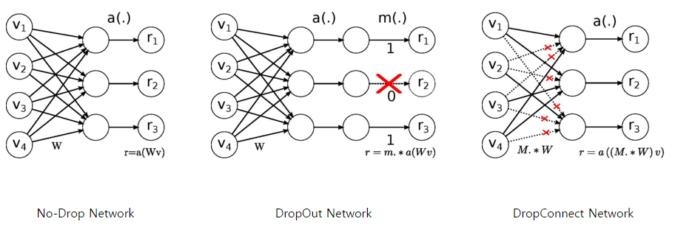
DropConnect
Instead of turning the neurons off (DropOut), DropConnect disconnects the connections between neurons.
Li Wan, Matthew Zeiler, Sixin Zhang, Yann LeCun, Rob Fergus "Regularization of neural networks using DropConnect.“ ICLML, 2013.

Slide 24
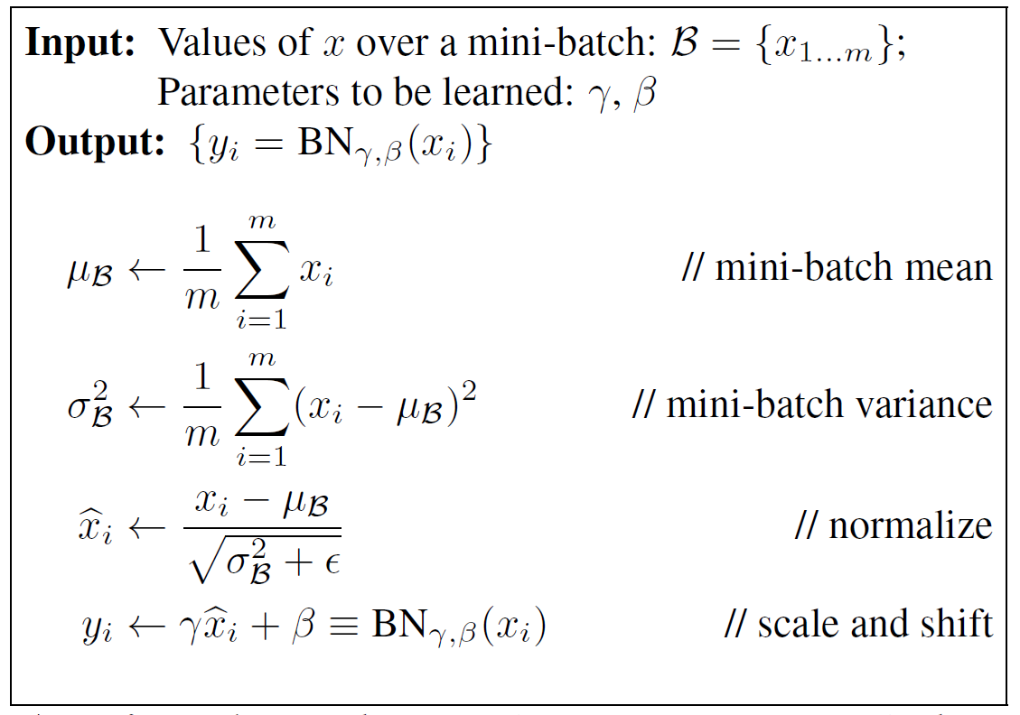
Batch Normalization
Benefits of BN
1. Increase learning rate
2. Remove Dropout
3. Reduce L2 weight decay
4. Accelerate learning rate decay
5. Remove Local Response Normalization
Notes:
Stablization -> can increase learning rate

Slide 25
Book review
1. Parameter Norm Penalties
2. Dataset Augmentation
3. Noise Robustness: to input, weights, and output
4. Semi-Supervised Learning = learning a representation
5. Multitask learning
6. Early Stopping
7. Parameter Tying and Parameter Sharing
8. Sparse representation
9. Bagging and Other Ensemble Methods
10. Dropout
11. Adversarial Training

Slide 26
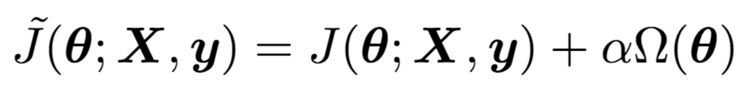
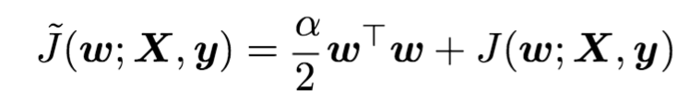
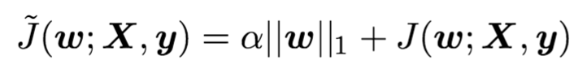
Parameter Norm Penalties
Many regularization approaches are based on limiting the capacity of models by adding a parameter norm penalty to the objective function.
L2 parameter regularization:
L1 parameter regularization:

Slide 27
Dataset Augmentation
The best way to make a machine learning model generalize better is to train it on more data.
Of course, in practice, the amount of data we have is limited. One way to get around this problem is to create fake data and add it to the training set.
Label preserving transformation is used.
Injecting noise in the input to a neural network can also be seen as a form of data augmentation.
Often, hand-designed dataset augmentation schemes can dramatically reduce the generalization error of a machine learning technique.

Slide 28
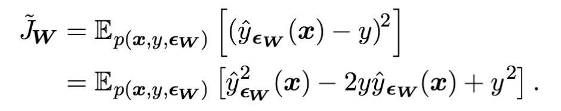
Noise Robustness
In the general case, it is important to remember that noise injection can be much more powerful than simply shrinking the parameters, especially when the noise is added to the hidden units.
Another way that noise has been used is by adding it to the weights.
Most datasets have some amount of mistakes in the y labels. Label-smoothing can be used in this regard.

Slide 29
Semi-Supervised Learning
In the paradigm of semi-supervised learning, both unlabeled examples and labeled examples are used to.
In the context of deep learning, semi-supervised learning usually refers to learning a representation.
The goal is to learn a representation so that examples from the same class have similar representations.
Unsupervised learning can provide useful cues for how to group examples in representation space.

Slide 30
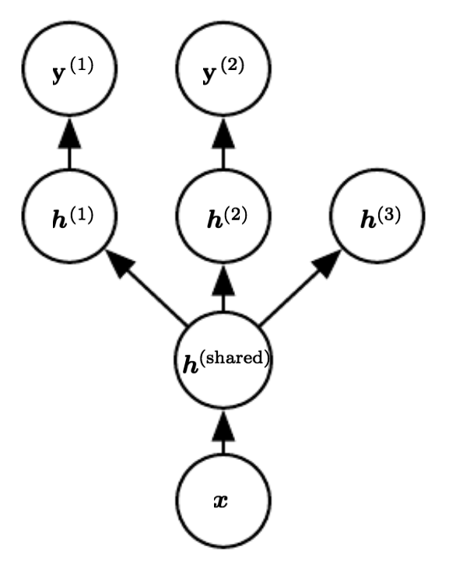
Multi-Task Learning
Multi-task learning is a way to improve generalization by pooling the examples arising out of several tasks.
Learning shared representation is a key point in multi-task learning.
From the point of view of deep learning, the underlying prior belief is the following:
“Among the factors that explain the variations observed in the data associated with the different tasks, some are shared across two or more tasks.”

Slide 31
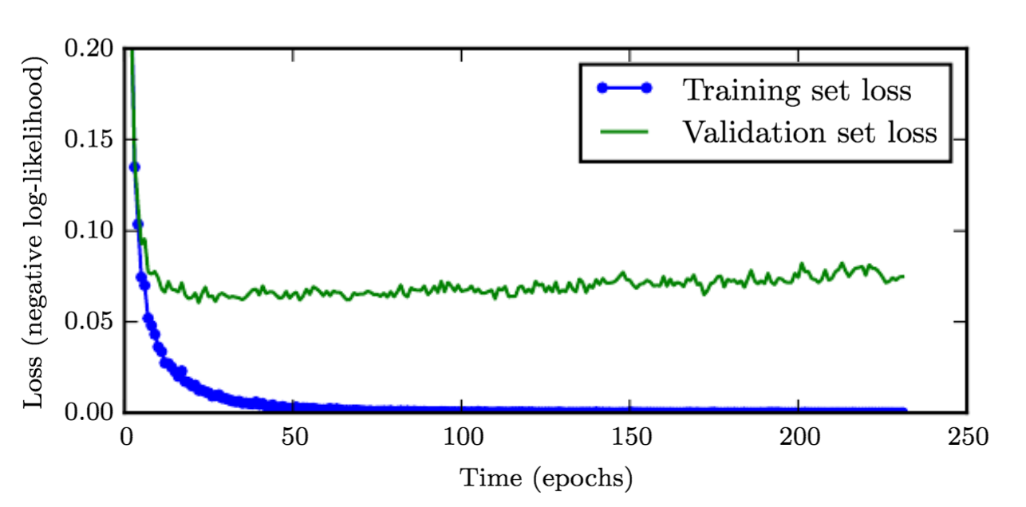
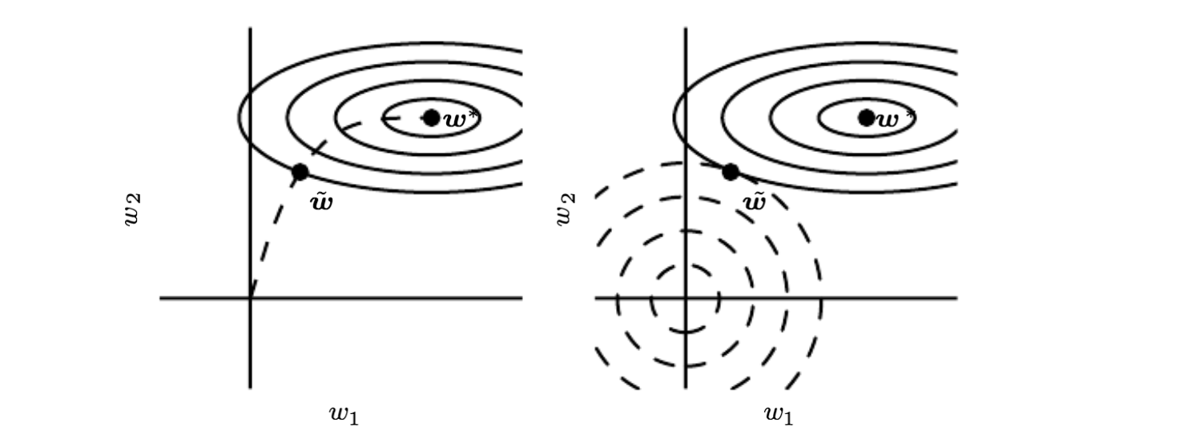
Early Stoping
When training large models with suﬃcient representational capacity to overﬁt the task, we often observe that training error decreases steadily over time, but validation set error begins to rise again.
Early stopping acts as a regularizer:

Slide 32
Parameter Tying and Parameter Sharing
A common type of dependency that we often want to express is that certain parameters should be close to one another.
Parameter Tying
Consider the following scenario: we have two models performing the same classification task (with the same set of classes) but with different input distributions.
Parameter Sharing
By far the most popular and extensive used of parameter sharing occurs in convolutional neural networks (CNNs).

Slide 33
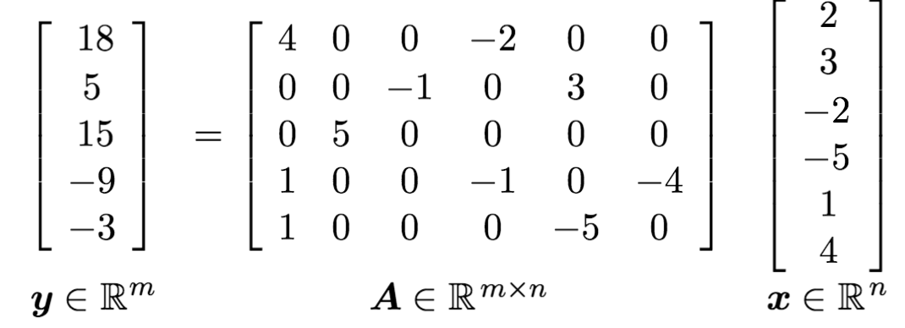
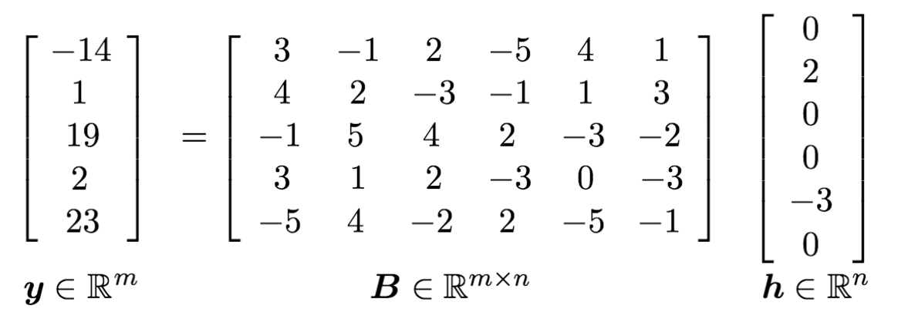
Sparse Representations
Representational sparsity describes a representation where many of elements are zero.
Sparse weights (L1 decay):
Sparse activations
Norm penalty regularization of representations is performed by adding to the loss function a norm penalty on the representations.

Slide 34
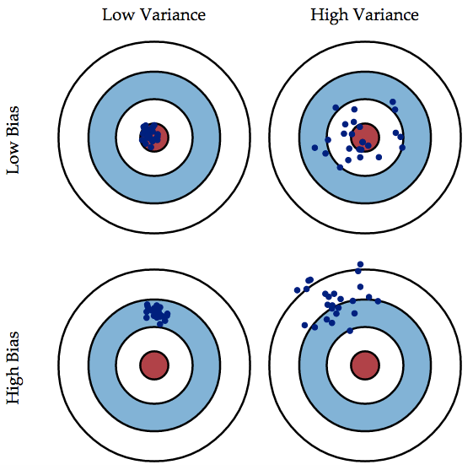
Bagging and Other Ensemble Methods
Bagging
Generate multiple sets of training data (with bootstrapping), multiple predictions and combine them with averaging prediction
Reduce overall variance using multiple low-bias models
Example: Random Forest
Bagging
Boosting
Boosting
Generate multiple weak learners and combine them to make a strong learner
Reduce overall bias using multiple weak learners
Example: Boosting, AdaBoost

Slide 35
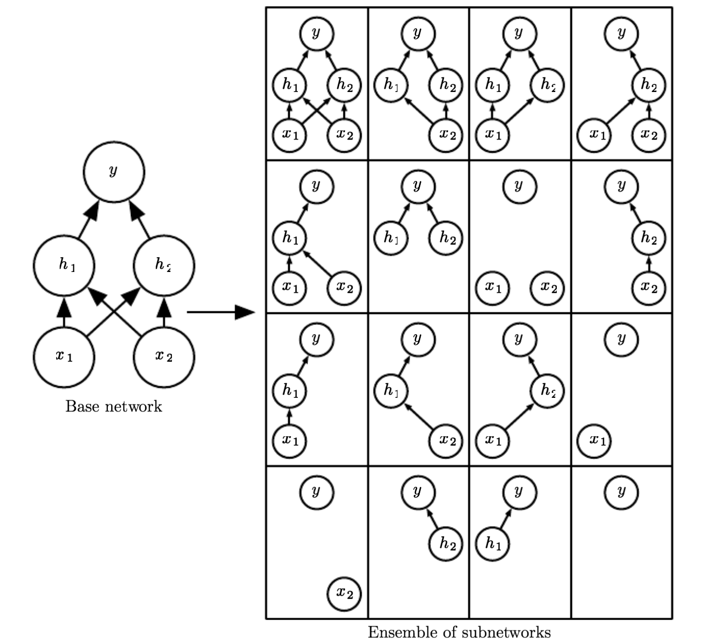
Dropout
One of the key insights of dropout is that training a network with stochastic behavior and making predictions by averaging over multiple stochastic decisions implements a form of bagging with parameter sharing.

Slide 36
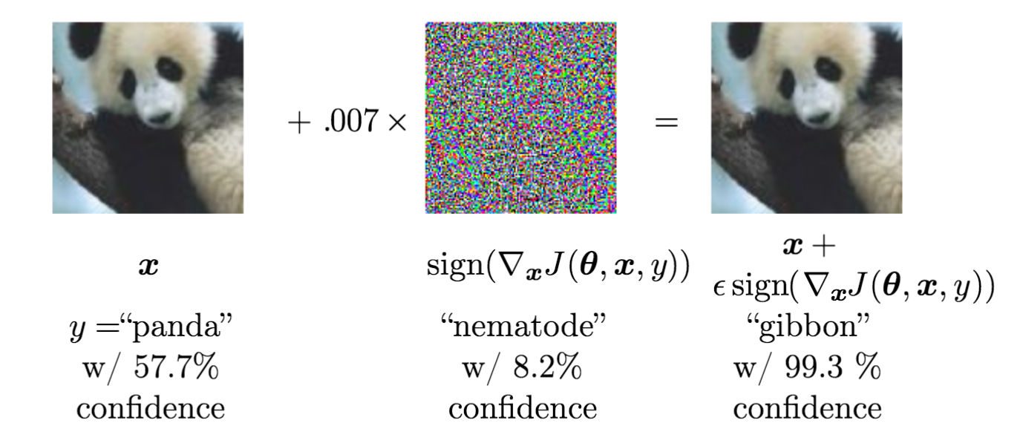
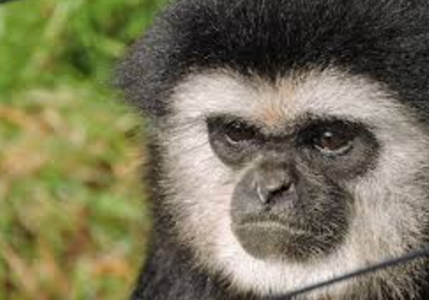
Adversarial Training
In many cases, neural networks have begun to reach human performance.
Examples that a human cannot tell the difference results in highly different predictions. These examples are called the adversarial examples.
Adversarial training is done via virtual adversarial examples.

Slide 37
Optimization methods
Sungjoon Choi
(sungjoon.choi@cpslab.snu.ac.kr)

Slide 38

Gradient descent?

Slide 39
Gradient descent?
There are three variants of gradient descent
Differ in how much data we use to compute gradient
We make a trade-off between the accuracy and computing time

Slide 40
Batch gradient descent
In batch gradient decent, we use the entire training dataset to compute the gradient.

Slide 41
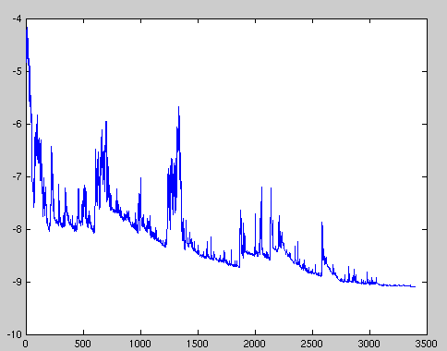
Stochastic gradient descent
In stochastic gradient descent (SGD), the gradient is computed from each training sample, one by one.

Slide 42

Mini-batch gradient decent
In mini-batch gradient decent, we take the best of both worlds.
Common mini-batch sizes range between 50 and 256 (but can vary).
Notes:
Rule of thumb : In English, the phrase rule of thumb refers to an approximate method for doing something, based on practical experience rather than theory

Slide 43
Challenges
Choosing a proper learning rate is cumbersome.
→ Learning rate schedule
Avoiding getting trapped in suboptimal local minima

Slide 44
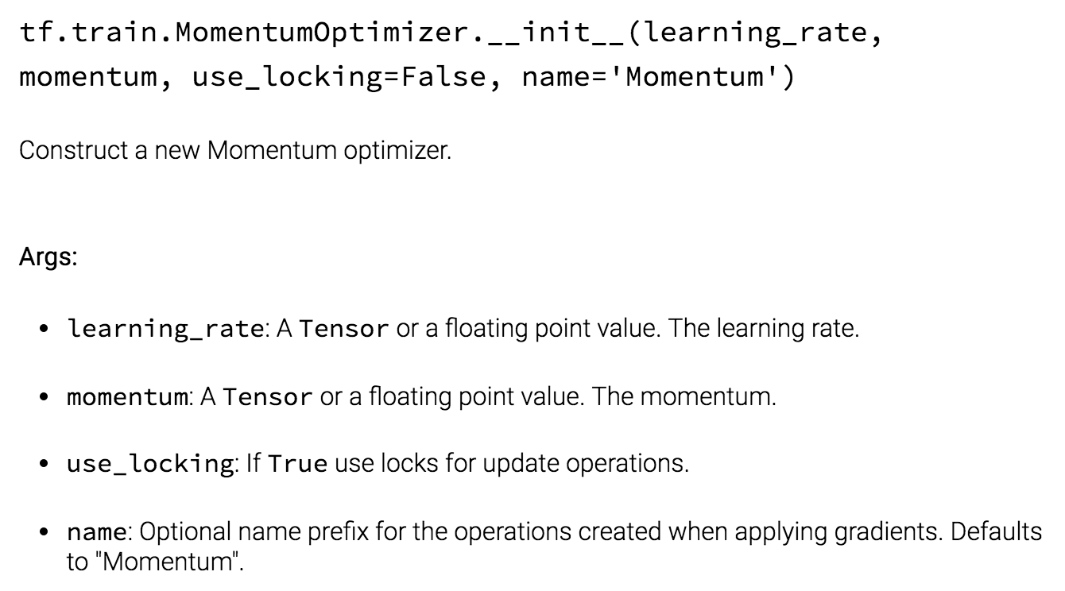
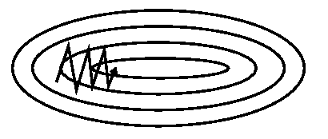
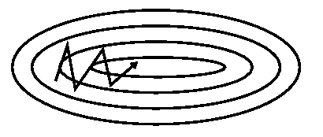
Momentum

Slide 45
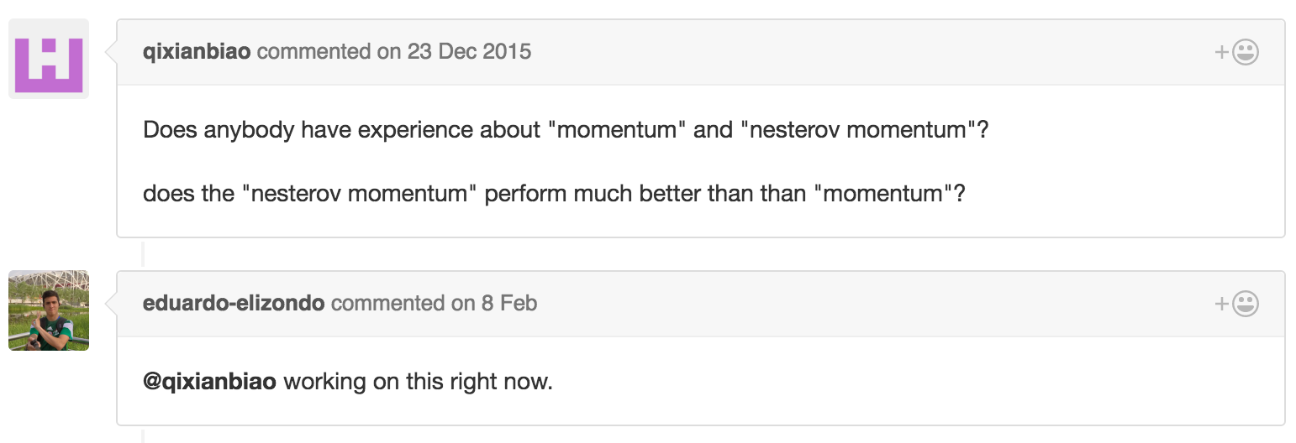
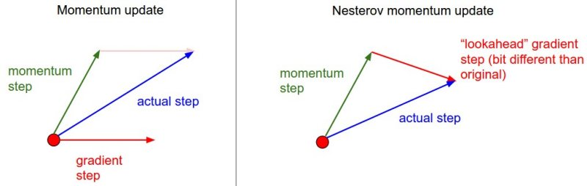
Nesterov accelerated gradient
Notes:
네스테로프 모멘텀은 '미리보기' 기능을 추가합니다. 이 방식은 현재 위치뿐만 아니라 모멘텀의 방향으로 조금 더 나아간 위치에서의 기울기를 고려하여 파라미터를 업데이트합니다. 즉, 공이 언덕을 내려올 때 미리 앞을 보고 조정하는 것과 같습니다. 이렇게 함으로써, 네스테로프 모멘텀은 파라미터 업데이트시 과도한 진동을 줄이고, 최적점으로의 수렴을 더 빠르게 할 수 있습니다.

Slide 46
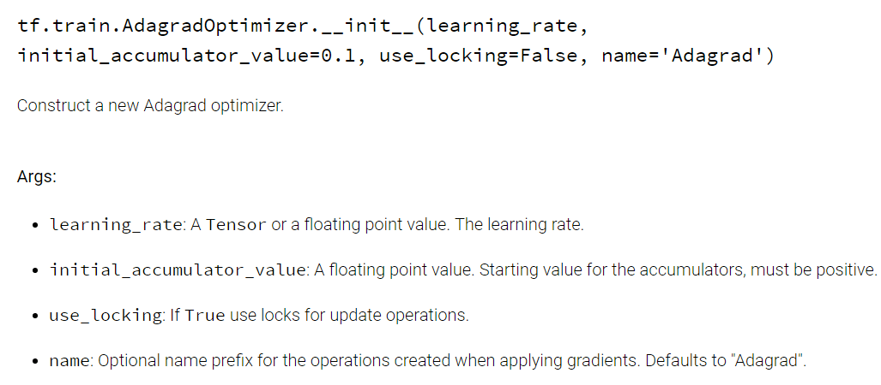

Adagrad
It adapts the learning rate to the parameters, performing larger updates for infrequent and smaller updates for frequent parameters.
$$θ_{t+1, i}=θ_{t, i}−\frac{η}{\sqrt{G_{t, ii}+ε}}g_{t, i}$$
Performing larger updates for infrequent and smaller updates for frequent parameters.

Slide 47
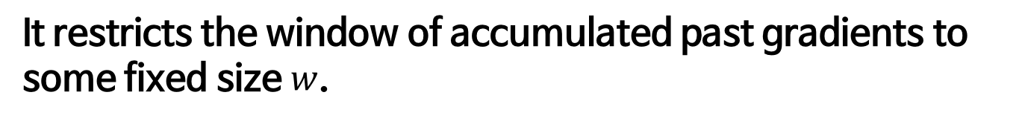

Adadelta
Adadelta is an extension of Adagrad that seeks to reduce its monotonically decreasing learning rate.
It restricts the window of accumulated past gradients to some fixed size $w$.
$$E{\left[g^{2}\right]}_{t}=γE{\left[g^{2}\right]}_{t−1}+\left(1−γ\right)g_{t}^{2}$$
$$E{\left[∆θ^{2}\right]}_{t}=γE{\left[∆θ^{2}\right]}_{t−1}+\left(1−γ\right)∆θ_{t}^{2}$$
No learning rate!
$$θ_{t+1}=θ_{t}−\frac{\sqrt{E{\left[∆θ^{2}\right]}_{t}+ε}}{\sqrt{E{\left[g^{2}\right]}_{t}+ε }}g_{t}$$

Slide 48
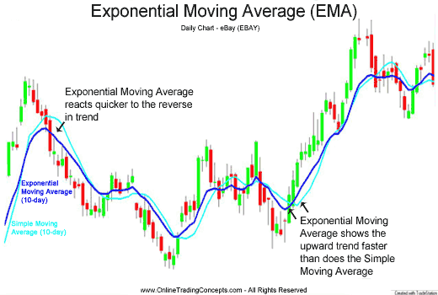
Exponential moving average

Slide 49
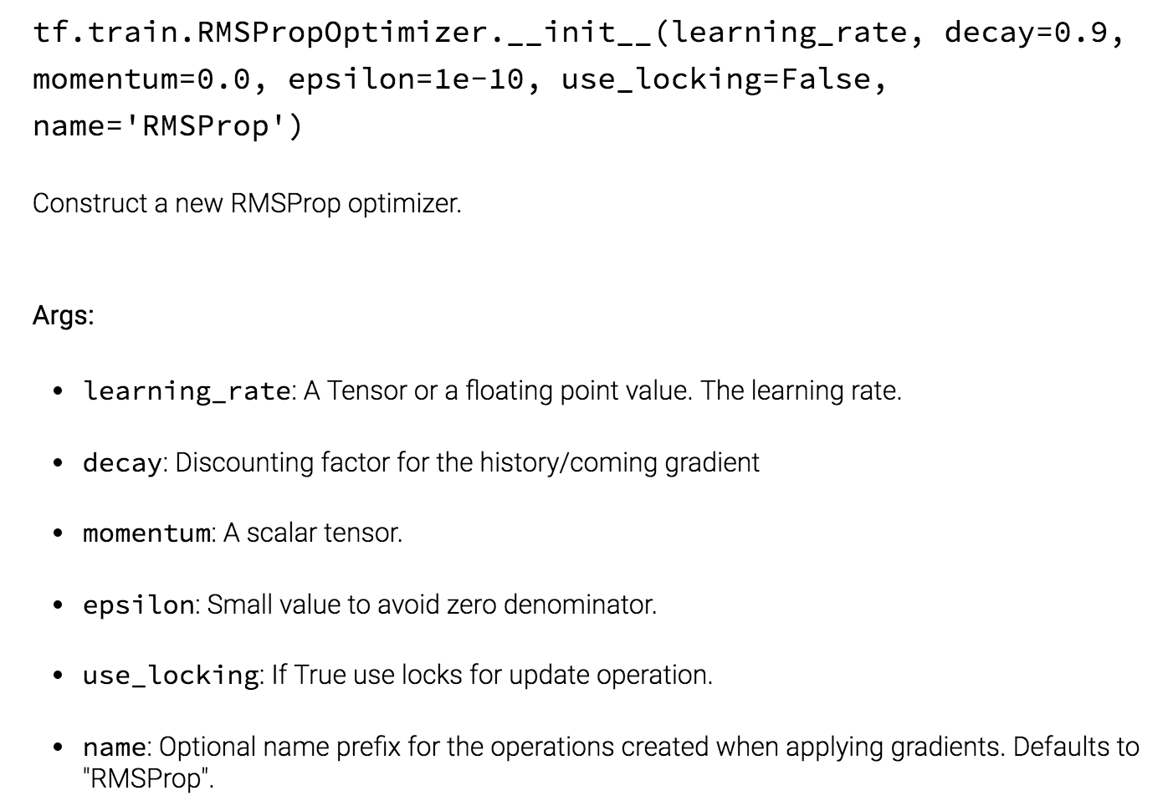

RMSprop
RMSprop is an unpublished, adaptive learning rate method proposed by Geoff Hinton in his lecture..
$$E{\left[g^{2}\right]}_{t}=γE{\left[g^{2}\right]}_{t−1}+\left(1−γ\right)g_{t}^{2}$$
$$θ_{t+1}=θ_{t}−\frac{η}{\sqrt{E{\left[g^{2}\right]}_{t}+ε }}g_{t}$$

Slide 50

Adam
Adaptive Moment Estimation (Adam) stores both exponentially decaying average of past gradients and and squared gradients.
$$m_{t}=β_{1}m_{t−1}+\left(1−β_{1}\right)g_{t}$$
Momentum
$$v_{t}=β_{2}v_{t−1}+\left(1−β_{2}\right)g_{t}^{2}$$
Running average of gradient squares
$$θ_{t+1}=θ_{t}−\frac{η}{\sqrt{v_{t}+ε}}{\frac{\sqrt{1−β_{2}^{t}}}{1−β_{1}^{t}}m}_{t}$$

Slide 51
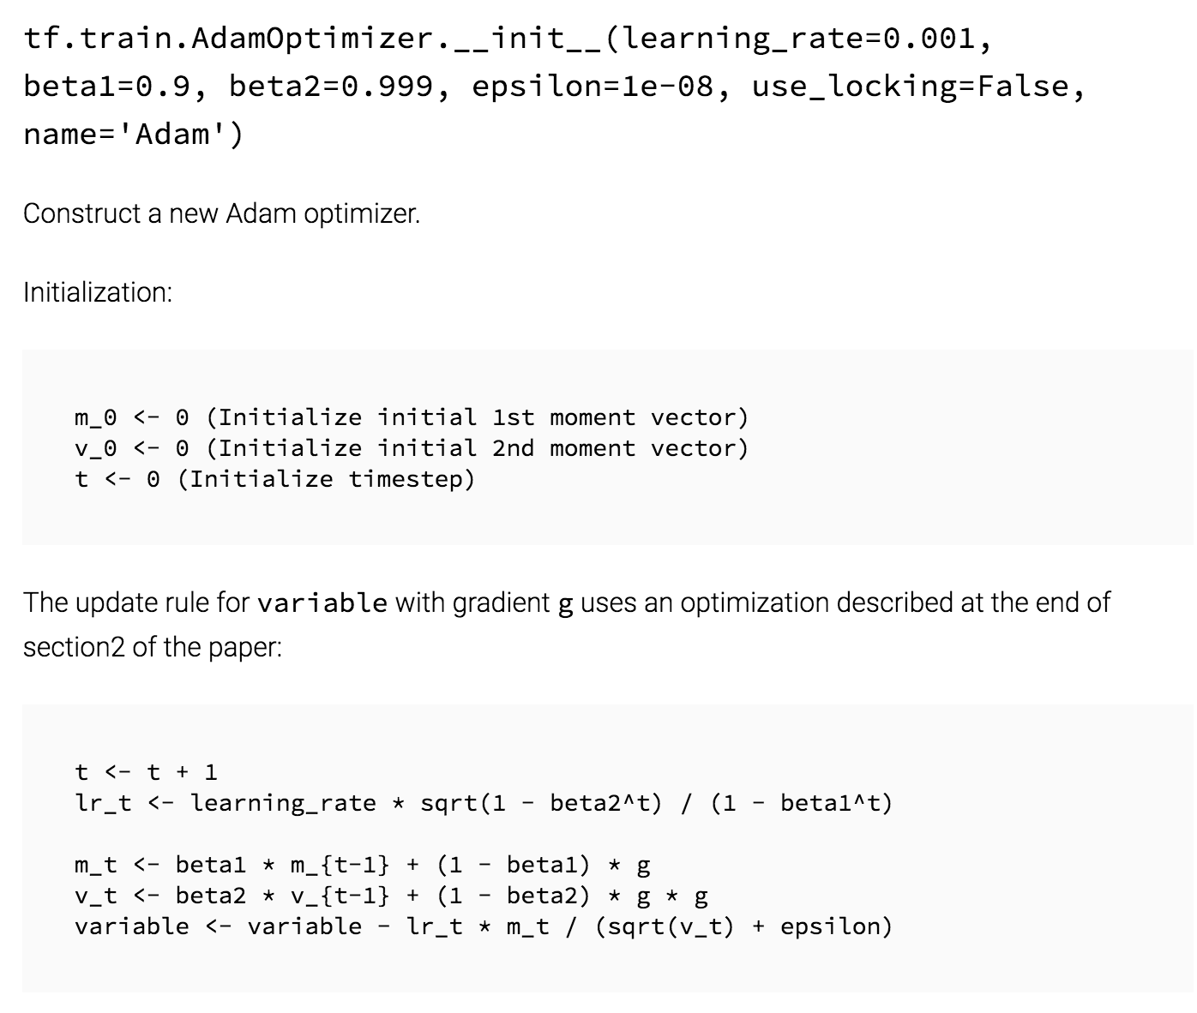

Adam
Adaptive Moment Estimation (Adam) stores both exponentially decaying average of past gradients and and squared gradients.
$$m_{t}=β_{1}m_{t−1}+\left(1−β_{1}\right)g_{t}$$
$$v_{t}=β_{2}v_{t−1}+\left(1−β_{2}\right)g_{t}^{2}$$
$$θ_{t+1}=θ_{t}−\frac{η}{\sqrt{v_{t}+ε}}{\frac{\sqrt{1−β_{2}^{t}}}{1−β_{1}^{t}}m}_{t}$$

Slide 52


Visualization

Slide 53
Which optimizer to use?
Use adaptive learning rate methods (Adagrad, Adadelta, RMSprop, Adam)
Adagrad decreases the learning rate of more activated features.
RMSprop extends Adagrad by dealing with radically diminishing learning rates (=Adadelta).
Adam adds bias-correction and momentum to RMSprop.

Slide 54



Shuffling

Slide 55
Curriculum Learning

Slide 56
Batch normalization

Slide 57
Early stopping

Slide 58

Gradient noise

Slide 59

Learning rate

